Slide 1


Manchester City Centurion Season

Slide 2

Overview
Manchester City F.C is the first club in the English Premier League history to score 100 points in a single season (17-18).
Our objective was to analyze how they achieved this.
Notes:
Analytics can be used in soccer to calculate the odds of winning .The data collected also known as metrics tells us about the teams strength and weaknesses of sa team .These metrics do not assume that goals accurately reflect how good a team is .

Slide 3
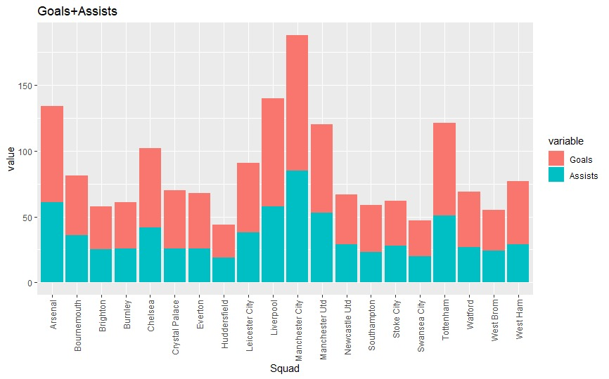
First, we analyzed the Total Goals + Assists of all teams in the Premier League (17-18)

Slide 4
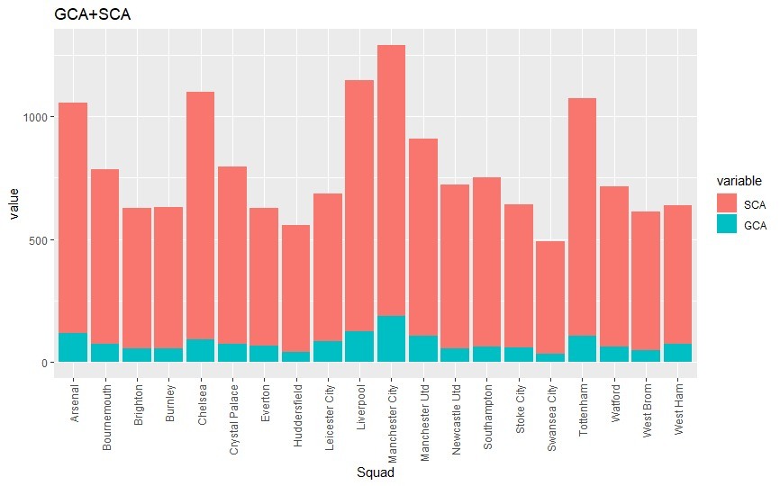
The Total Shot-Creating Actions (SCA) + Goal-Creating Actions (GCA)
Notes:
SCA -- Shot-Creating Actions
The two offensive actions directly leading to a shot, such as passes, dribbles and drawing fouls. Note: A single player can receive credit for multiple actions and the shot-taker can also receive credit.
GCA
GCA -- Goal-Creating Actions
The two offensive actions directly leading to a goal, such as passes, dribbles and drawing fouls. Note: A single player can receive credit for multiple actions and the shot-taker can also receive credit.

Slide 5
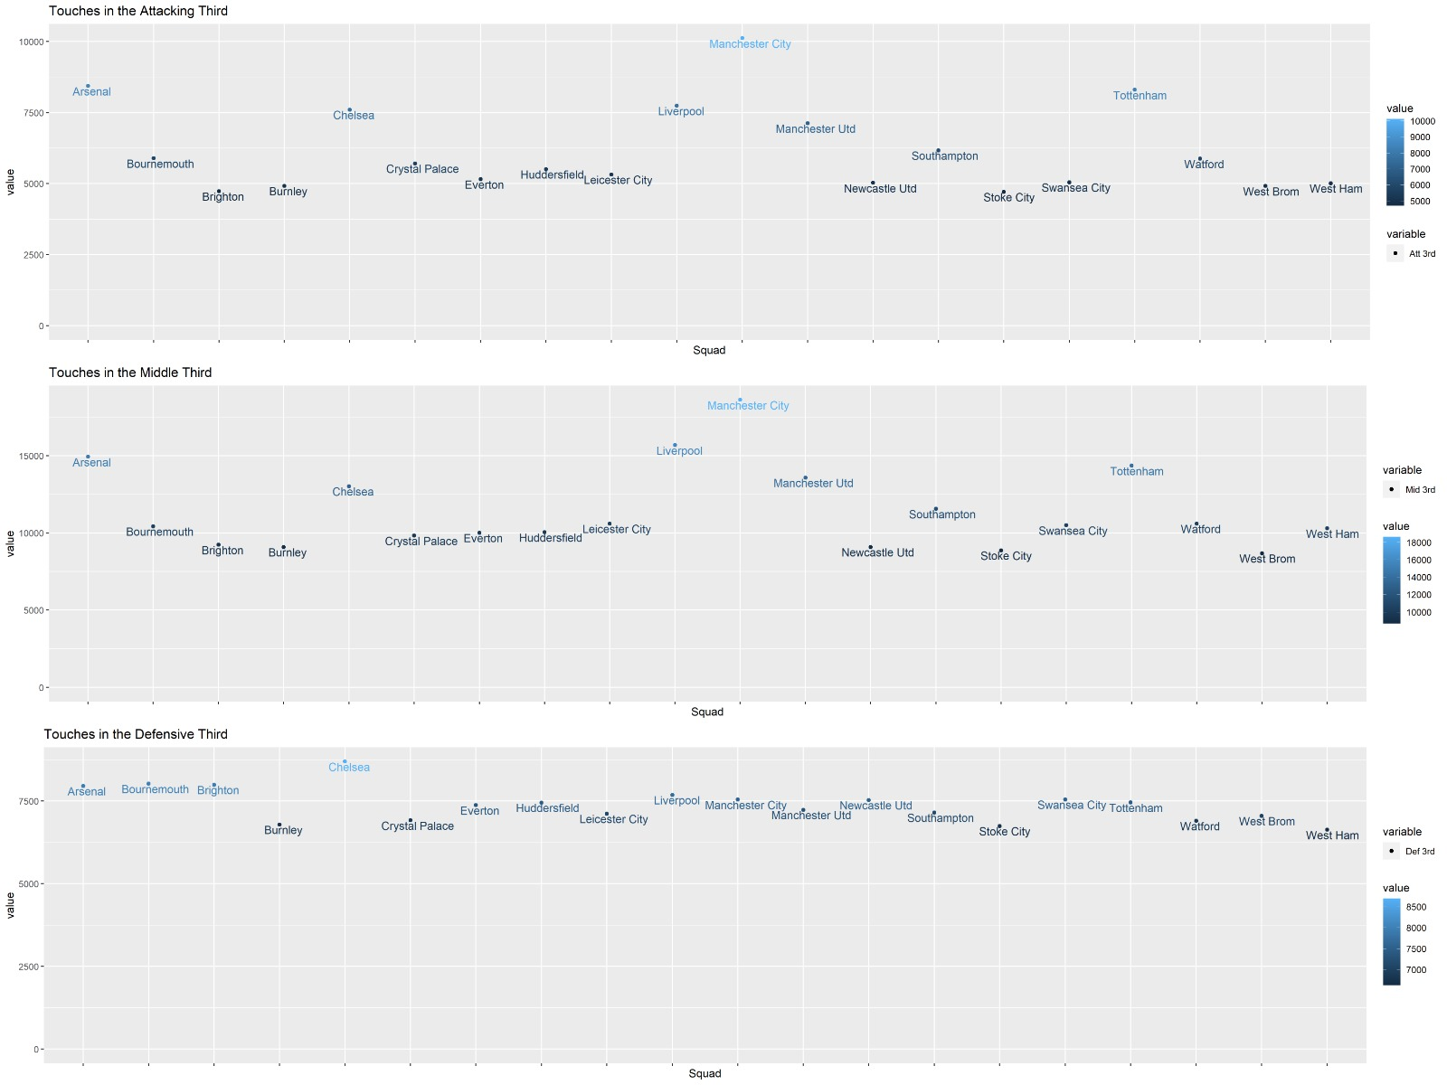
Which part of the field Manchester City dominated possession?

Slide 6
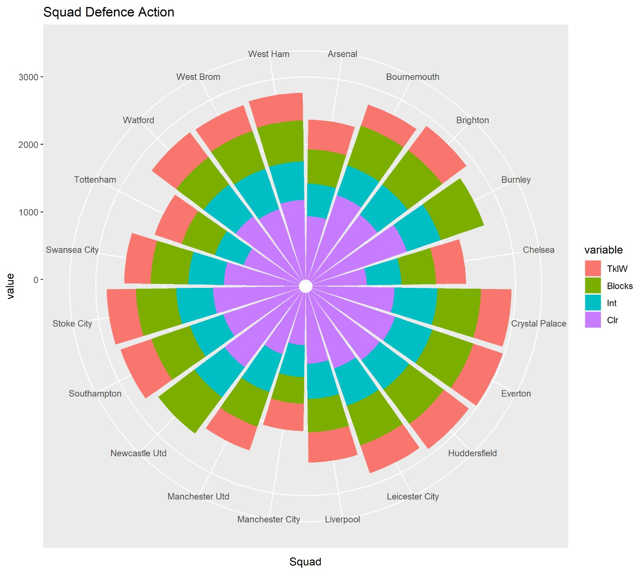
Squad Defensive Action
Notes:
Tackles won
Blocks
Interceptions
Clearances

Slide 7
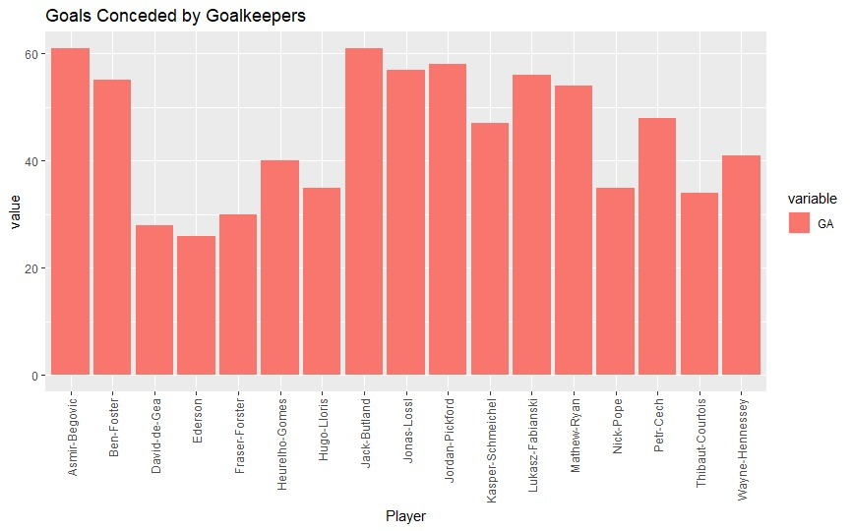
Goals conceded by Goalkeepers
Notes:
>=20 matches to select keepers

Slide 8
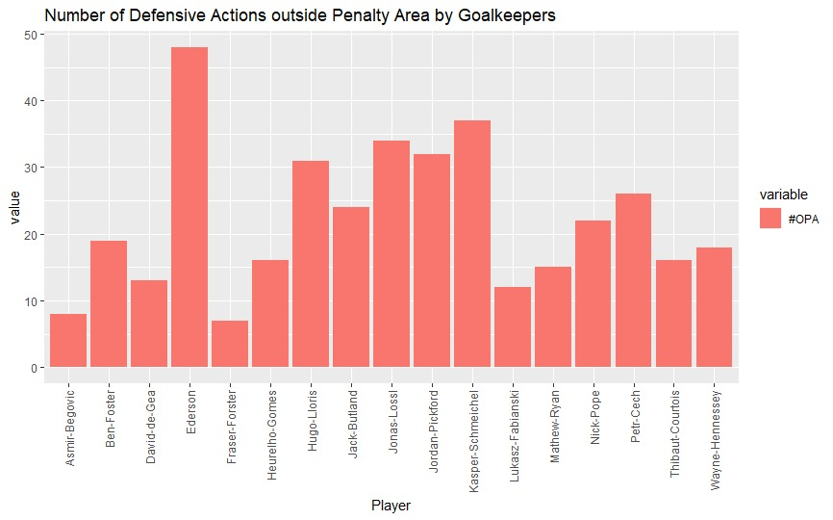
Number of Defensive Actions outside Penalty Area by Goalkeepers
Notes:
>=20 matches to select keepers

Slide 9





Big 6
VS

Slide 10
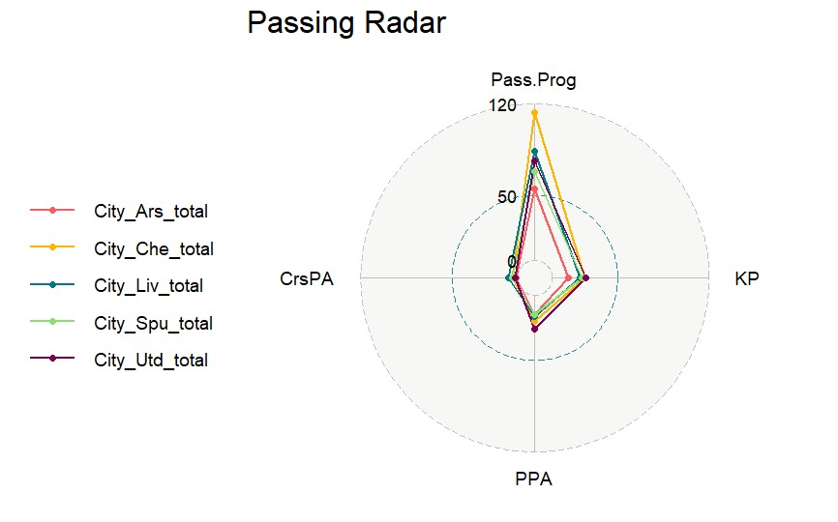
Passing Radar for City VS Big 6

Slide 11
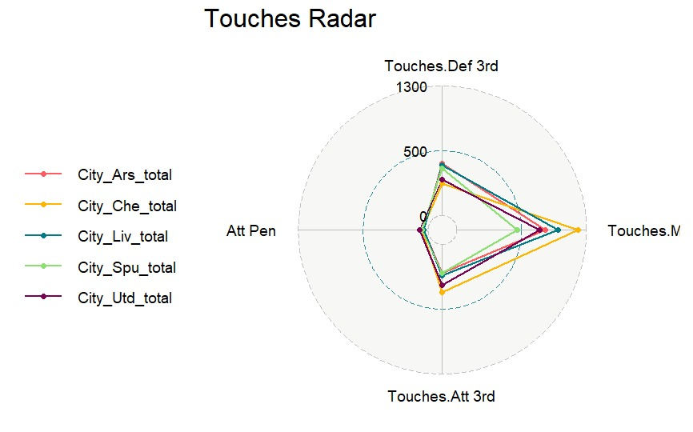
Touches Radar for City VS Big 6

Slide 12
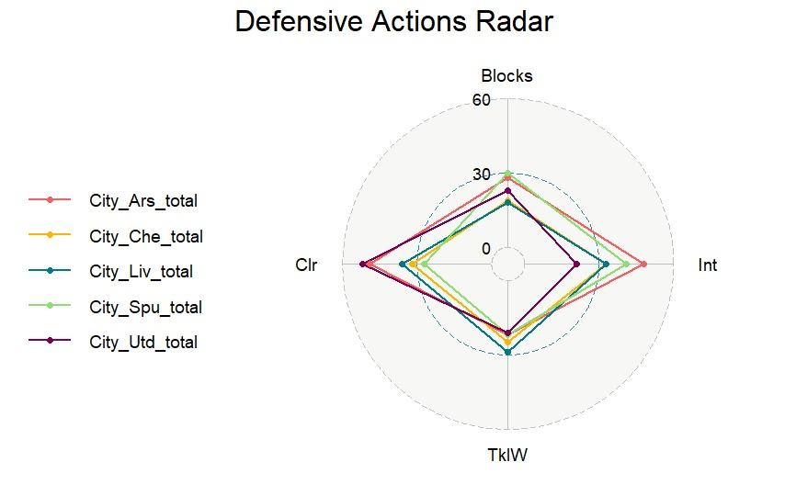
Defensive Actions Radar for City VS Big 6

Slide 13
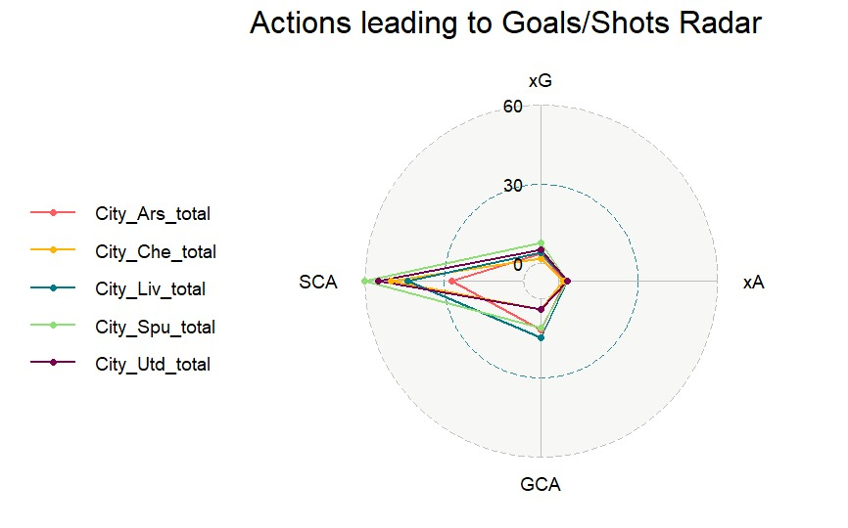
Attacking Radar for City VS Big 6

Slide 14
Most Valuable Players (MVPs)

Slide 15
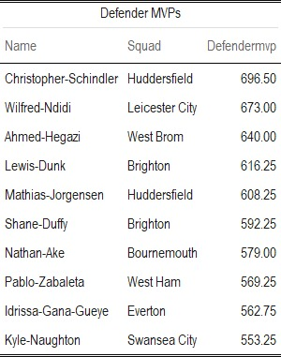
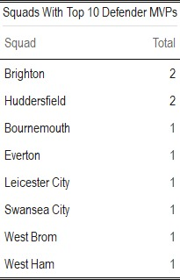
Most Valuable Defenders (Defender MVPs)
Notes:
To calculate the “Defendermvp” score we used: “Press” which tells us about how the player applied pressure to the opposition team. We also used tackles, interceptions, blocks and clearances as important metrics for a defender.

Slide 16
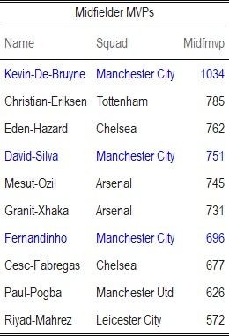
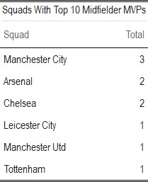
Most Valuable Midfielders (Midfielder MVPs)
Notes:
To calculate the “Midfieldermvp” score we used: SCA, GCA, Progressive Carries, Key Passes, and Progressive Passes.

Slide 17
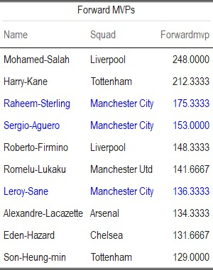
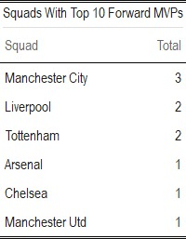
Most Valuable Forwards (Forward MVPs)
Notes:
To calculate the “Forwardmvp” score we used: Goals, Assists, and touches in the penalty area of the opposition

Slide 18
“I need time, but as soon as possible, we are going to try to create team spirit. That is the most important thing. After that, you can create tactics, but we have to create something special with ourselves.”
-Pep Guardiola

Slide 19
RESOURCES
https://fbref.com/en/
https://www.rdocumentation.org/

Slide 20


THANKS!
Do you have any questions?

